Slide 1
https://www.youtube.com/watch?v=6pPP67Qu9K8

Slide 2
Заказчик-исполнитель: распространенные ошибки и способы избежания Oleksandr Krakovetskyi CEO, DevRain Solutions @msugvnua, alex.krakovetskiy@devrain.com

Slide 3
About
CEO of DevRain Solutions – software development.
Co-founder of DonorUA and uDonors.
Microsoft Regional Director.
Microsoft Most Valuable Professional (Windows Development Platform).
Community Lead in Kyiv Smart City.
Open Data Expert in State Agency for E-Governance in Ukraine.
Best Professional in Software Architecture (Ukrainian IT Award).
Ph.D. in Computer Science.

Slide 4


Slide 5
~80% of projects are not successful * project considered successful if budget and schedule exceed not more than 20% compared from the planned ones

Slide 6
Common issues
Requirements.
Estimates.
Communication.
Technologies.
Cost.

Slide 7
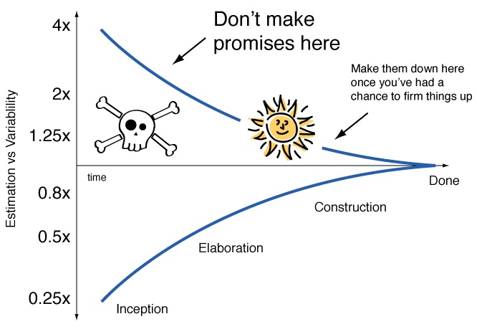
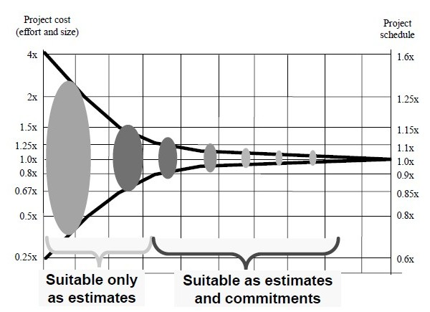
Error cost (cone of uncertainty)
At the beginning of any project we don’t know exactly how long a project is going to take.
No two ever projects have:
The same requirements.
The same people.
The same business context.
The same technology.
The same priorities & constraints.

Slide 8
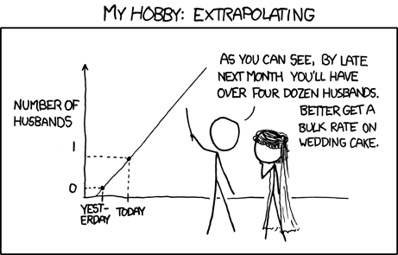
Development is non-linear process
Increasing number of team members == increasing of communication complexity.
Development is not about time and resources, it is about people and services.
Productivity of junior/middle developer and “guru” may differ up to 5-10 times.

Slide 9
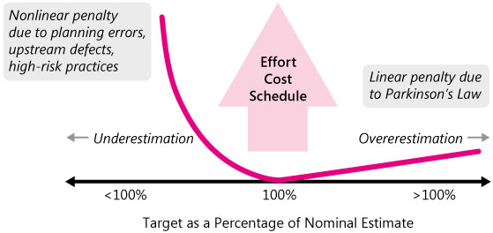
Parkinson's Law
Parkinson's Law states that work expands to fill the time available for it. Result? Extra time gained is wasted.

Slide 10
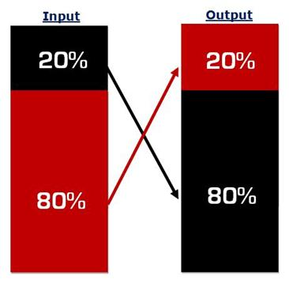
Pareto Law
The Pareto principle states that, for many events, roughly 80% of the effects come from 20% of the causes.

Slide 11
Zone of improbability
9 women can’t make a baby in a month
*25% - max volume of project squeezing time
Fred Brooks “Mythical man month”, 1975

Slide 12
“Zero” stage
Estimation, environment installation (staging and production), creating accounts for all team members, understanding roles and management flow
*it’s good to have “zero” stage completed as soon as possible

Slide 13
Very simple estimation model
Hours per feature * Number of features

Slide 14
Simple estimation model
Hourly rate * hours * 1.3 = project cost
~30% - project risks (employees search, bug fixing, requirements missing, illness, lacks of communication, lazy developers)
Payable hour != standard hour

Slide 15
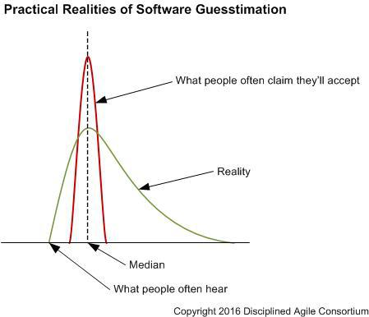
Guesstimation
An estimate is a rough approximation or calculation, in other words a guess. Unfortunately, too many people think that estimates are promises, or worse yet guarantees.
There is ample evidence that the initial estimate for a software development project should be given in a range of -25% to +75%, so your million dollar project should be quoted as a range of $750,000 and $1,750,000.
http://www.disciplinedagiledelivery.com/software-guesstimation/

Slide 16

Two estimations (best/worse cases)
(Cbc * Pbc) + (Cwc * Pwc)
Cbc – cost (best case)
Pbc – probability (best case)
Cwc – cost (worse case)
Pwc – probability (worse case)
Real cost will be higher than best/worse average cost.

Slide 17
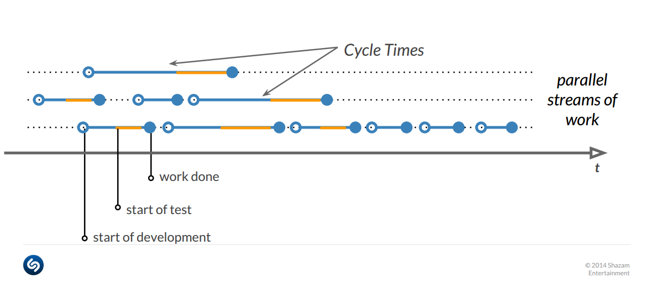
Probability estimation model (Shazam)
When will all the Stories get done?
1. You can get these Stories within X days with 85% probability.
2. Probability of you getting them within a week is Y%.

Slide 18
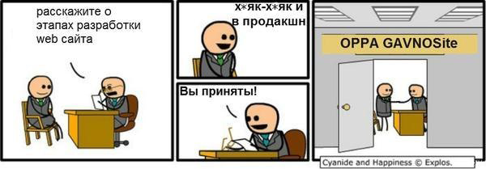
Different goals
Customers are worried about business
Developers are worried about technologies and ideal code
Об идеальном коде и суровой реальности
https://habrahabr.ru/post/167877/

Slide 19
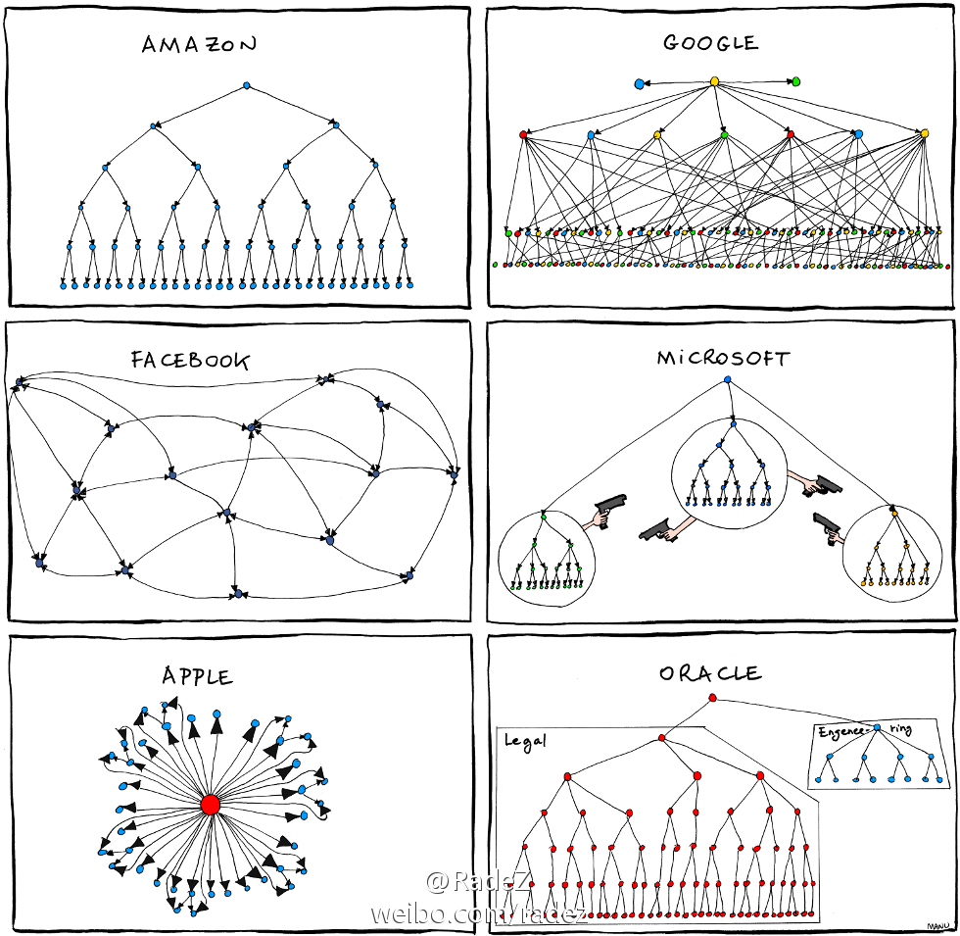
Communication
Ask yourself do you know:
who determines the business strategy of the project?
who will evaluate the quality of your work and what is “project done” criteria?
how many bosses do you have?
who has the final voice in decisions?

Slide 20
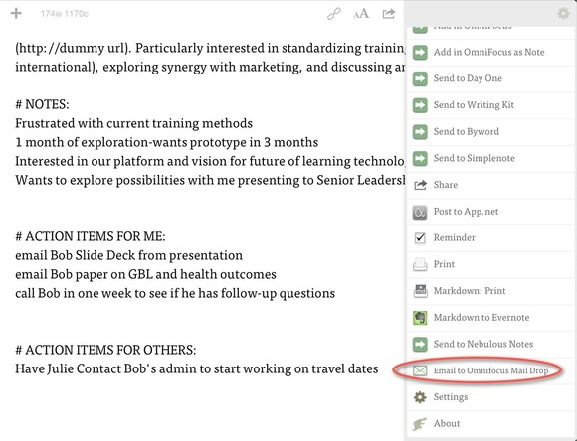
Communication
All deals should be in written form (email).
Start using PM tool as earlier as can.
Documents: contract, requirements, prototype.

Slide 21
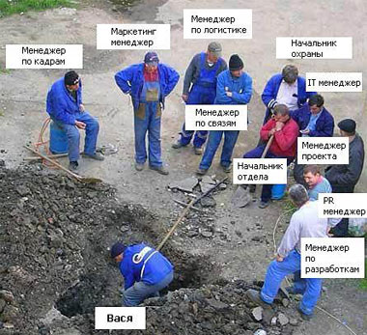
Roles not titles
Job title == many roles
Every team member should know his roles.
Avoid too many “bosses” (ideally just one).

Slide 22
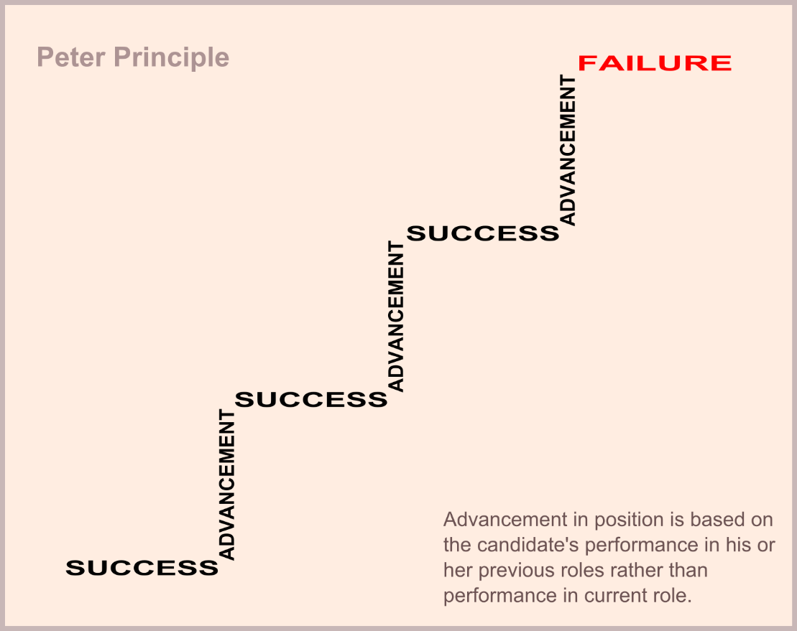
Peter principle
The Peter principle is a concept in management theory formulated by Laurence J. Peter in which the selection of a candidate for a position is based on the candidate's performance in their current role, rather than on abilities relevant to the intended role. Thus, employees only stop being promoted once they can no longer perform effectively, and "managers rise to the level of their incompetence."

Slide 23
Process highlights
With integration to customer’s process Team should be totally aware with customer’s business process.
Without integration to customer’s process Teams use own process internally and use a “public interface” to customer’s business process. Interfaces can be differ with different customers.
Orientation on result, not the process Agile is not good in all 146% cases. Sometimes F*ckup Development works better.

Slide 24
Process highlights
UX/UI & guidelines & graphic design Exactly in this order
If development for several platforms Make at least alpha version for the one platform with real data, than – other platforms
Time to first solution (estimate/answer) is very critical
Avoid “not invented here” philosophy Don’t hesitate to use already existing products, research, standards, or knowledge even if they are paid.
Use best tools Collaboration & communication, storage, documents exchange, source controls, tasks management, Wiki & CRM, feedback etc.

Slide 25
What tools we use
UX/UI, collaboration, communication, source control, docs management, education

Slide 26
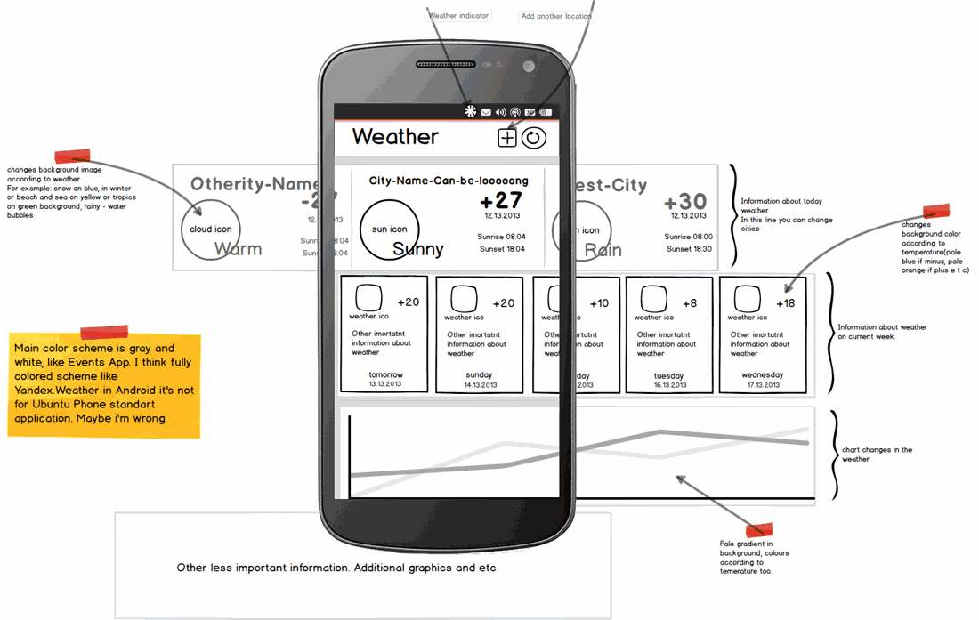
UX/UI & Prototyping
MockupBuilder, Balsamiq:
sketchy wireframes;
UI components & icons;
drag & drop simplicity;
click-through prototypes.

Slide 27
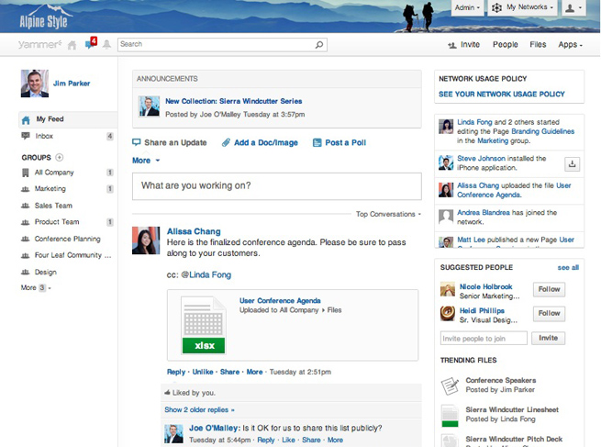
Collaboration
Yammer:
Freemium enterprise social network service that was launched in 2008 and sold to Microsoft in 2012.
Yammer is used for private communication within organizations and is an example of enterprise social software.
Access to a Yammer network is determined by a user's Internet domain so that only individuals with appropriate email addresses may join their respective networks.

Slide 28
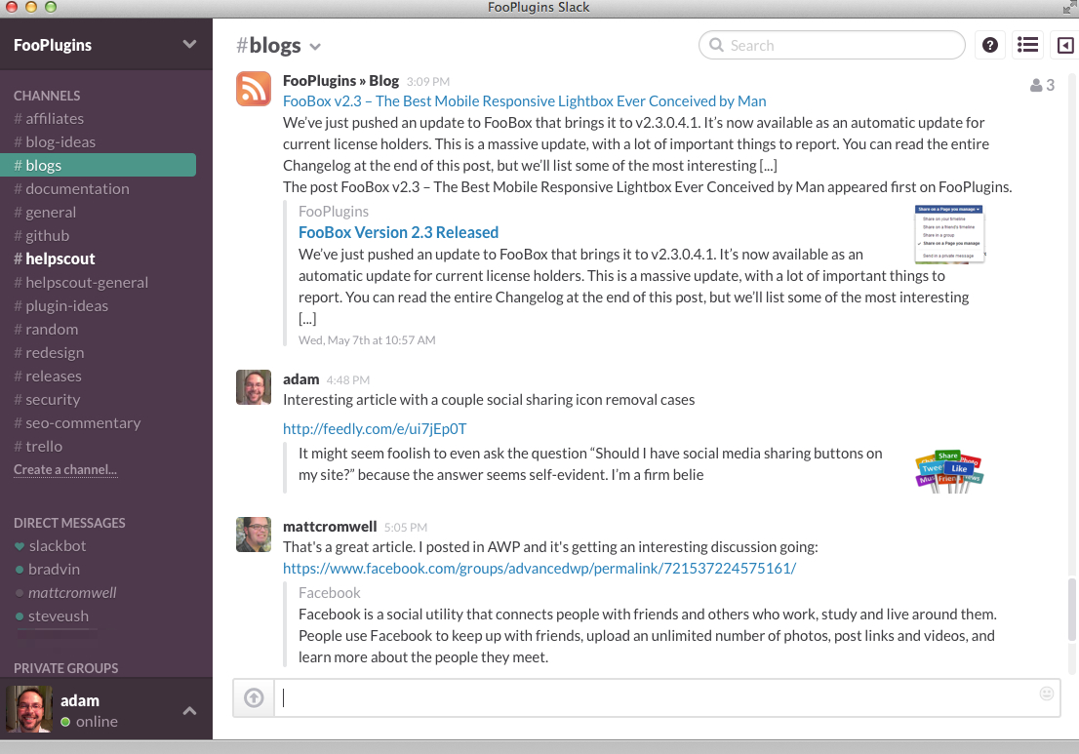
Collaboration
#Slack:
Slack brings all your communication together in one place. It's real-time messaging, archiving and search for modern teams.

Slide 29
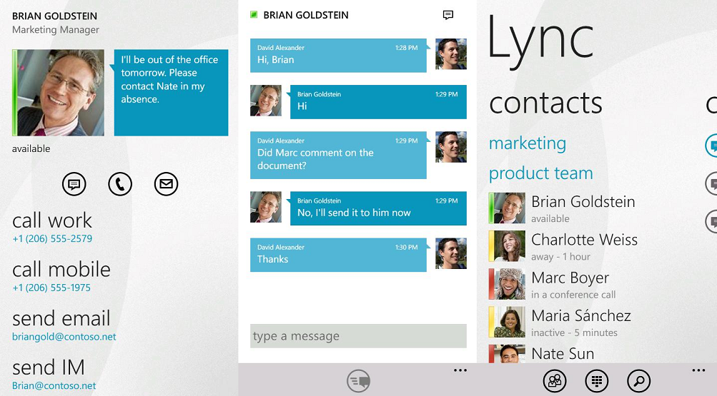
Communication
Skype:
for small group conversation;
share screen, group video chat (premium).
Lync:
for big groups (webinars);
easy recording, powerful interaction features.

Slide 30
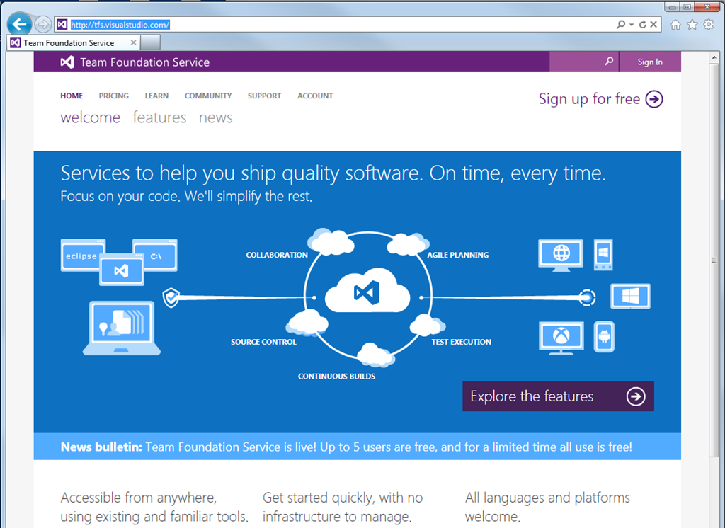
Source control
TFS Online:
cloud solution;
free for small groups;
natively integrated with Visual Studio.
Alternatives:
Codeplex.com;
Bitbucket.com;
Github.com.

Slide 31
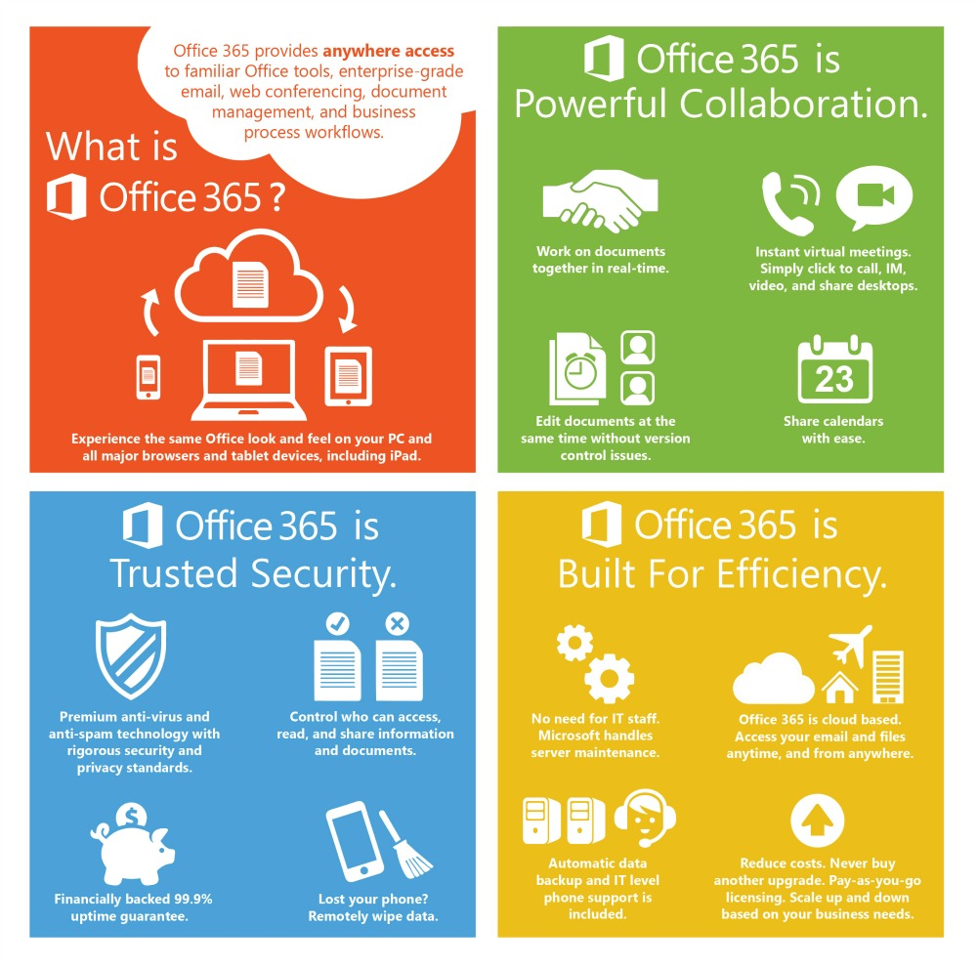
Other tools
OneDrive & Dropbox For files storage
Google Docs & Office 365 & DocuSign For docs management
Asana For task management
Bitrix 24 CRM

Slide 32
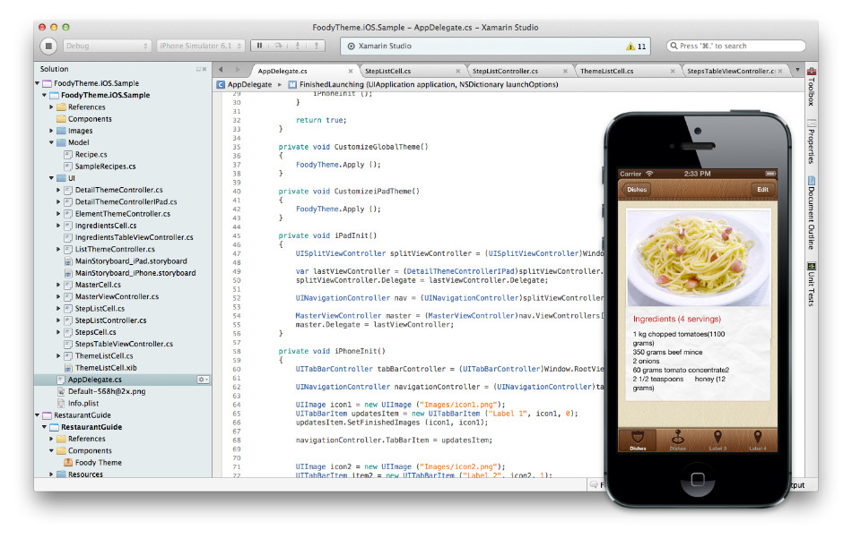
3rd party tools and services
Telerik Controls & tools
Xamarin For cross platform development
RedGate SQL Server, .NET, Oracle tools
Pluralsight Hardcore Dev and IT Training

Slide 33
Q&A
Alex.Krakovetskiy@devrain.com
@msugvnua

